Slide 1
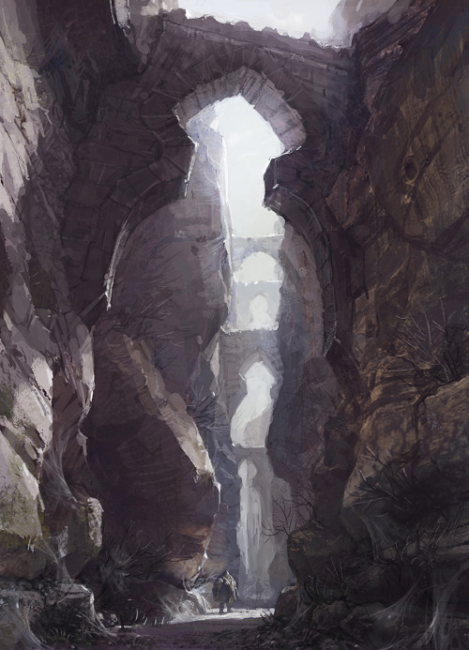
Notes:
1 - Canyon Beginning
2 - Canyon Circle after Maze
3 - Blue Wild Magic Wisp
4 - Blue Wild Magic Pixie
5 - Blue Wild Magic Bear
6 - Schools of Magic

Slide 2
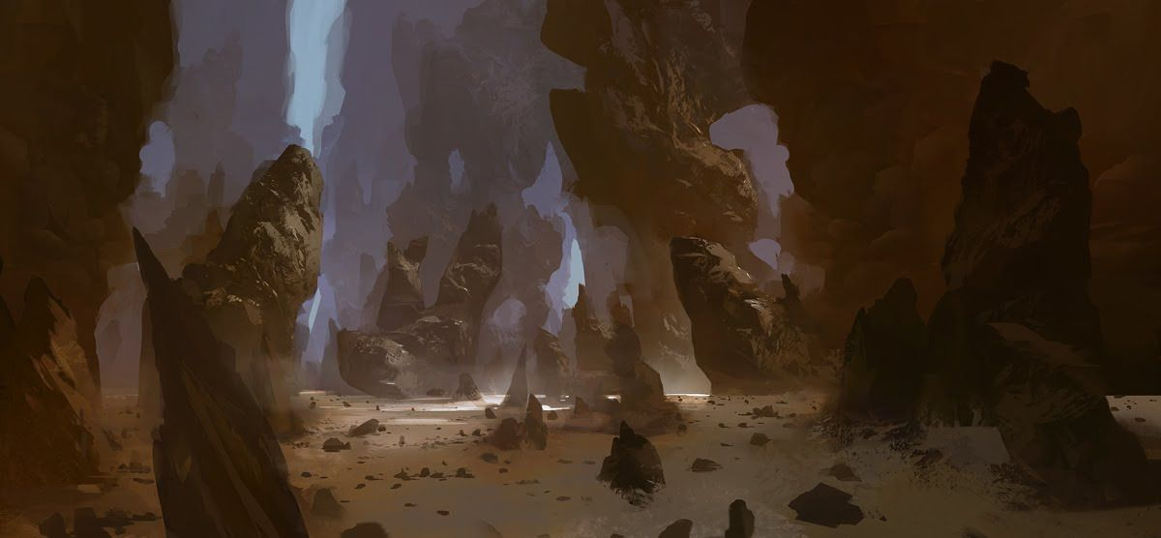
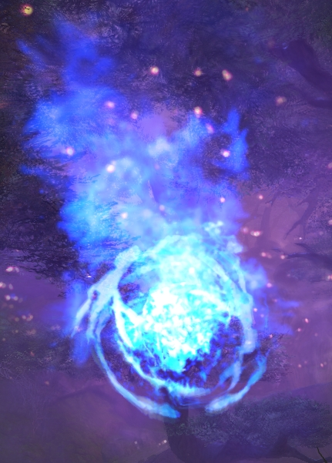
Notes:
1 - Canyon Beginning
2 - Canyon Circle after Maze
3 - Blue Wild Magic Wisp
4 - Blue Wild Magic Pixie
5 - Blue Wild Magic Bear
6 - Schools of Magic

Slide 3
Notes:
1 - Canyon Beginning
2 - Canyon Circle after Maze
3 - Blue Wild Magic Wisp
4 - Blue Wild Magic Pixie
5 - Blue Wild Magic Bear
6 - Schools of Magic

Slide 4
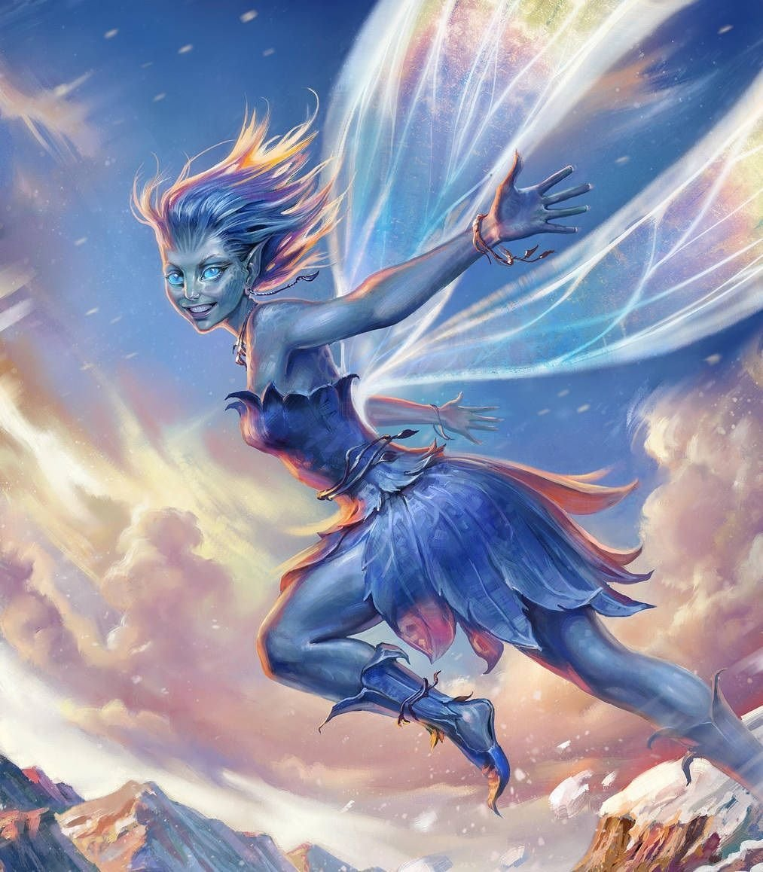
Notes:
1 - Canyon Beginning
2 - Canyon Circle after Maze
3 - Blue Wild Magic Wisp
4 - Blue Wild Magic Pixie
5 - Blue Wild Magic Bear
6 - Schools of Magic

Slide 5
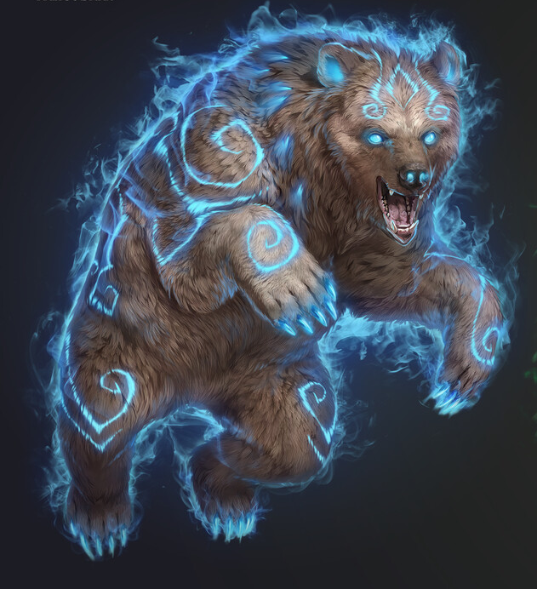
Notes:
1 - Canyon Beginning
2 - Canyon Circle after Maze
3 - Blue Wild Magic Wisp
4 - Blue Wild Magic Pixie
5 - Blue Wild Magic Bear
6 - Schools of Magic

Slide 6
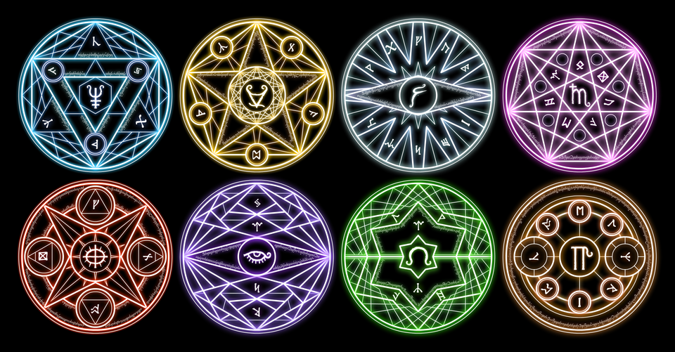
Notes:
1 - Canyon Beginning
2 - Canyon Circle after Maze
3 - Blue Wild Magic Wisp
4 - Blue Wild Magic Pixie
5 - Blue Wild Magic Bear
6 - Schools of Magic

